Slide 1

Stock Price Trend Prediction using Machine Learning on Financial Statements
James Liao 490851
Lawrence Yang 489746
Ming Xu 489773
Yanzhong Lai 489763
EyeCatching Capital

Slide 2
Content
Database Description
Overview
NA Problem
Data Cleansing & Multiples Selection
SelectKbest
Random Forests
Manual Selection
Model Result
Simple Neural Network Model
Summary & Future works
EyeCatching Capital

Slide 3
Database Description-Overview
Total of 38,000 rows, 2,182,031 elements
Total of 55 multiples
Total of 11 Industries
Total of 124,878 NA elements (5%)
EyeCatching Capital

Slide 4
Database Description- Overview
Total Rows by Industry
High
Industrials | 5,142
Financial_Services | 5,059
Technology | 4,947
Healthcare | 4,752
Consumer_Cyclical | 4,445
Consumer_Defensive | 2,516
Real_Estate | 2,256
Utilities | 2,172
Communication_Services | 1,593
Basic_Materials | 1,528
Energy | 1,361
Database Overview
Symbol | Date | Period | Current_Ratio | Quick_Ratio | Cash_Ratio
AAPL | 2021-09-15 | Q4 | 1.074 | 0.909 | 0.278
AAPL | 2021-06-26 | Q3 | 1.061 | 0.887 | 0.315
AAPL | 2021-03-27 | Q2 | 1.141 | 0.966 | 0.361
AAPL | 2021-09-26 | Q1 | 1.163 | 1.022 | 0.271
Low
EyeCatching Capital

Slide 5
Database Description- NA Problem
Total NA number by Industry
High
Healthcare | 39,913
Industrials | 21,375
Consumer_Cyclical | 15,661
Energy | 12,458
Technology | 11,854
Utilities | 9,107
Financial_Services | 7,063
Consumer_Defensive | 3,021
Real_Estate | 1,814
Basic_Materials | 1,528
Communication_Services | 1,084
Total of 28,158 rows have NA
If drop rows by NA, database will last 9, 825 rows
Other Method
Rank features and select top important features to avoid insufficient data problem
Low
EyeCatching Capital

Slide 6
Data Cleansing & Multiples Selection
Data Cleansing & Multiples Selection- SelectKBest
Steps
ANOVA F-score
Regression F-score
SelectPercentile
SelectFpr
Applied on 11 separated database by industry
Find intersection and select mutual top features
Drop NA from selected top features
Ranking
EyeCatching Capital

Slide 7
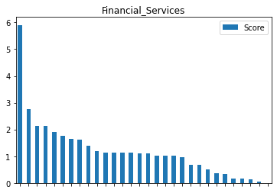
Data Cleansing & Multiples Selection- SelectKBest
 | Simply Drop NA for all | Select Top 10 Features + Drop NA
Total Rows Remain (Out of 38,000) | 9,825 | 35,600
Ranking & Selecting is efficient to keep important features and avoid NA Problem
Features selection using ANOVA F-score
EyeCatching Capital

Slide 8
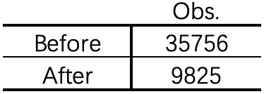
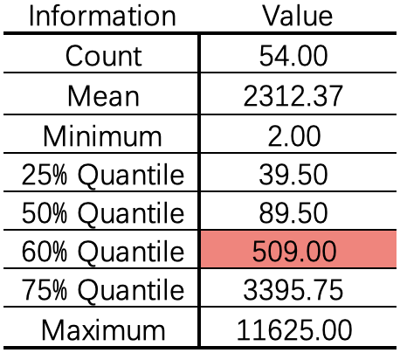
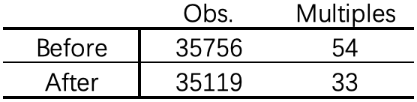
Data Cleansing & Multiples Selection- Random Forests
Cannot drop observations including NA values directly
72.5%
Without prior knowledge, try to filter out multiples with a certain level of NA values
Critical Value
≥ 509, 60% Quantile
EyeCatching Capital

Slide 9
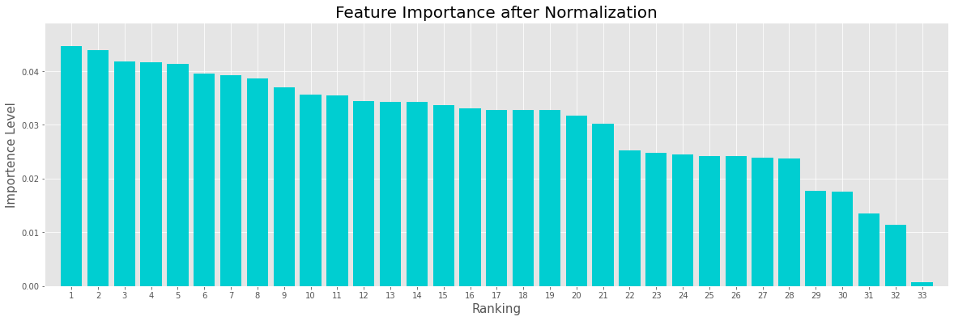
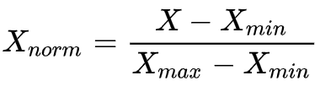
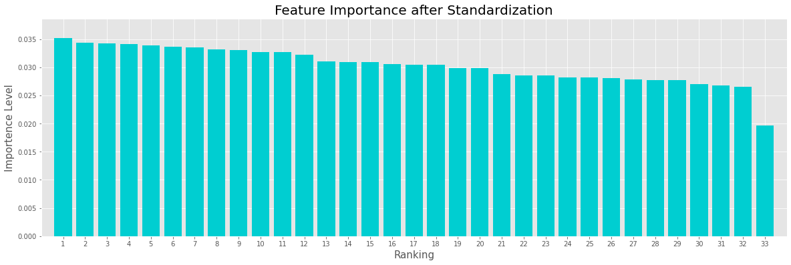

Data Cleansing & Multiples Selection- Random Forests
Min-Max Normalization
Might be Biased without
excluding outliers
Z-Score Standardization
EyeCatching Capital

Slide 10
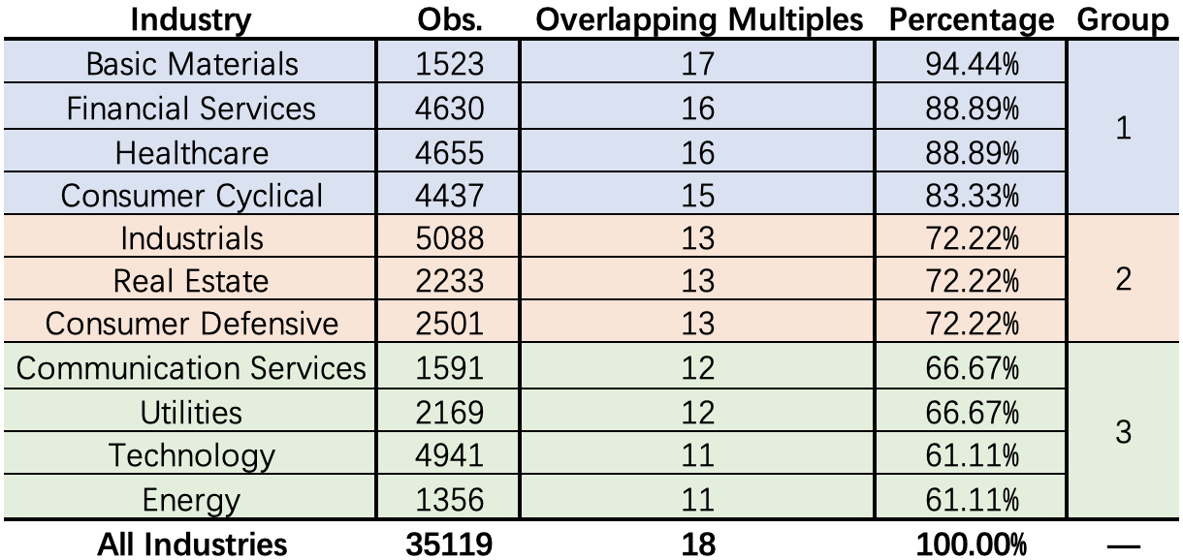
Data Cleansing & Multiples Selection- Random Forests (11 groups -> 3 groups)
Focus on multiples with importance levels higher than average score (0.03 = 1/33)
EyeCatching Capital

Slide 11
Data Cleansing & Multiples Selection- Manual Selection (Literature Review)
Category | Typical Multiples
Liquidity Ratio | Current ratio Quick ratio
Activity Ratio | Days of sales outstanding Days of inventory outstanding Days of payable outstanding
Profitability Ratio | ROE ROA
Solvency Ratio | Debt Ratio Financial Leverage
Market Ratio | P/E P/S
Utility
debt ratio → debt-to-equity ratio
Healthcare
Multiple Adjustment
debt ratio→debt-to-capitalization
ROA → operating profit margin
Technology
quick ratio → cash ratio
ROA → gross profit margin
……
EyeCatching Capital

Slide 12
Model Result - Simple Neural Network Model
Industry: Technology
Train size: 0.7
Structure: 4 layers ( 8 + 16 + 16 + 1)
Activation Function for last layer: Sigmoid
Loss Function: binary_crossentropy
Epochs: 300
Batch Size: 50
 | Result | Target
Loss | 0.42 | < 0.2
Accuracy | 0.73 | >0.8
Validation Accuracy | 0.66 | >0.8
Can be improved
EyeCatching Capital

Slide 13
Summary & Future works
Multiples Evaluation and Future Work:
Two automated selection SelectKBest and Random Forest can solve the NA problem.
The manually selected multiples will be adjusted according to different industry characteristics.
We will form industries into larger group, using unsupervised learning methods.
Model Evaluation and Future Work:
The performance of Simple NN model can be improved. The scale of model is too shallow, so we will reconstruct it by applying grid search or random search for parameters optimization.
We will apply other different approaches such as LSTM and SVM in the future.
EyeCatching Capital

Slide 14
References
[1] Jermsittiparsert, Kittisak & Ambarita, Dedy & Mihardjo, Leonardus & K Ghani, Erlane. (2019). Risk-Return through Financial Ratios as Determinants of Stock Price: A Study from ASEAN Region. Journal of Security and Sustainability Issues. 9. 199-210. 10.9770/jssi.2019.9.1(15).
[2] Deji-Olarerin A , Folorunso O , Vincent O R , et al. STOCK PRICE TREND PREDICTION USING SUPPORT VECTOR MACHINE AND CORAL REEF OPTIMIZATION ALGORITHM[J]. 2020.
[3] Nair B B , Mohandas V P , Sakthivel N R . A Genetic Algorithm Optimized Decision Tree-SVM based Stock Market Trend Prediction System[J]. International Journal on Computer Science & Engineering, 2010, 2(9).
[4]Amel-Zadeh, Amir and Calliess, Jan-Peter and Kaiser, Daniel and Roberts, Stephen, Machine Learning-Based Financial Statement Analysis (November 25, 2020).
[5]Akhtar, T. (2021). Market multiples and stock returns among emerging and developed financial markets. Borsa Istanbul Review, 21(1), 44-56.
[6] Junyoung, Heo, Jin, et al. SVM based Stock Price Forecasting Using Financial Statements[J]. KIISE Transactions on Computing Practices, 2015, 21(3):167-172.
EyeCatching Capital

Slide 15
Thanks for listening!

Slide 16
Q & A
EyeCatching Capital

